Slide 1
Decision Tree

Slide 2
Decision Tree
- ClAssification and Regression Tree (CART)

Slide 3
You are building a recommendation system and you are suppose to provide recommendations of suggesting App based on Gender and occupation
Which one you would suggest for the following people ?

Slide 4
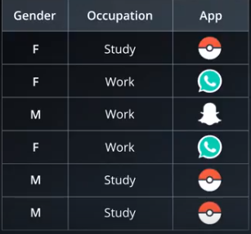
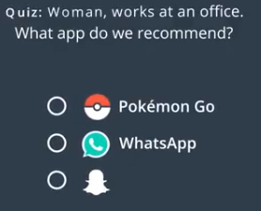
Recommendation System - 1

Slide 5
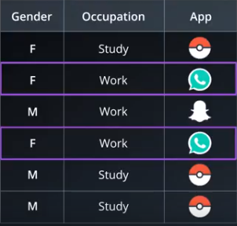
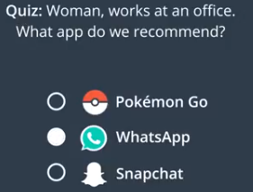

Slide 6
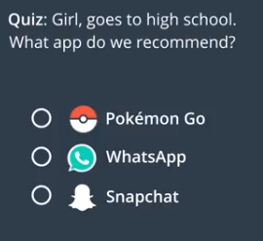
Recommendation System - 2

Slide 7
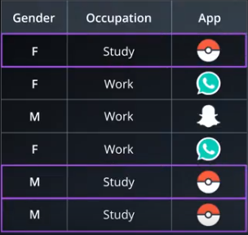
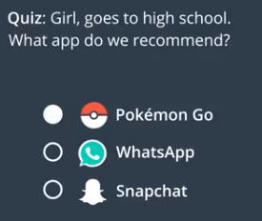

Slide 8
That was pretty Easy right …

Slide 9
That was pretty Easy right …
But what if we had to choose between Gender and Occupation to suggest an App

Slide 10
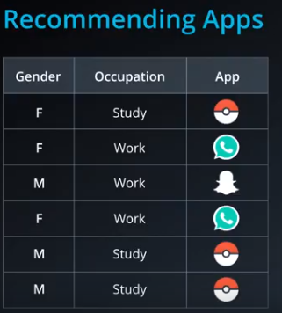
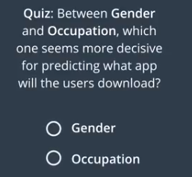
Way Machine approaches

Slide 11
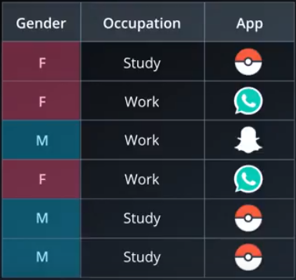
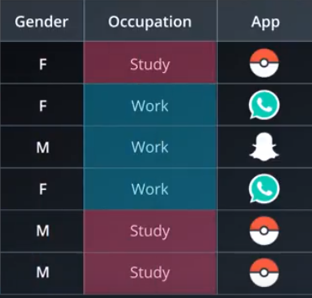

Slide 12
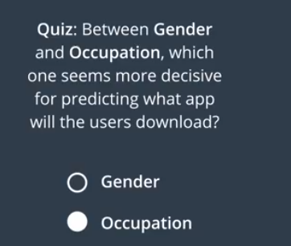

Slide 13
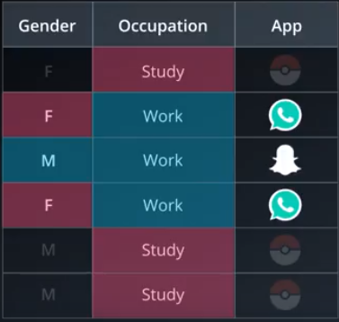
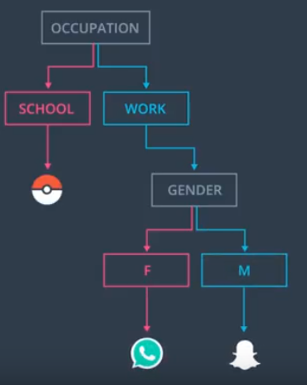
Construction of

Slide 14
Decision Tree Algorithm also works in the same way as we think …

Slide 15
Terminologies

Slide 16
Terminologies
Root Node
Decision node
Leaves

Slide 17
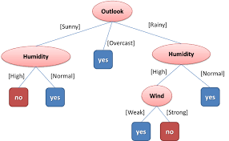
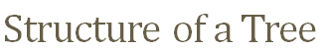
Supervised learning algorithm
Root Node -
Decision node -
Leaves -

Slide 18
Supervised learning algorithm
Root Node - Outlook
Decision node - Humidity/Wind
Leaves - Yes/No

Slide 19
How do we find the Root node ?

Slide 20
How to find Root (2 Ways)
Information gain(Entropy)
Gini index

Slide 21
Understand Entropy you will get to understand
Information Gain

Slide 22
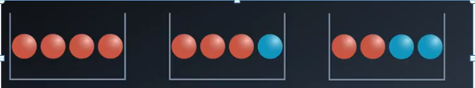
Entropy or Randomness - The measure of uncertainty

Slide 23
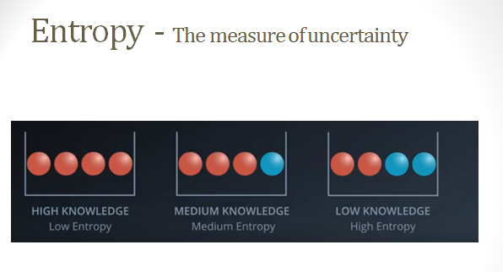

Slide 24
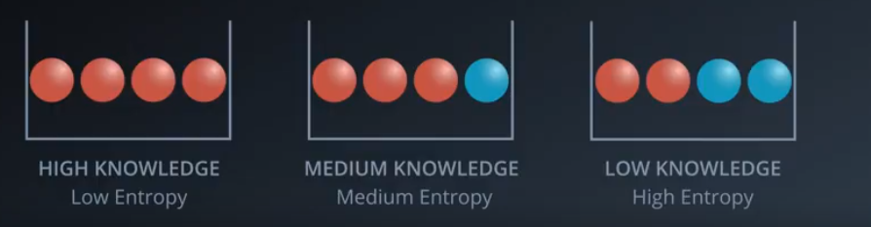
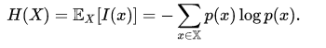
Entropy - The measure of uncertainty

Slide 25
Information Gain | Entropy

Slide 26
Information Gain & Entropy
Information Gain -> Information theory -> Entropy
Entropy = Randomness or Uncertainty of a random variable.

Slide 27
Information Gain & Entropy
Information Gain -> Information theory -> Entropy
Entropy = Randomness or Uncertainty of a random variable.
There are 2 steps for calculating information gain for each attribute:
Calculate entropy of Target.
Calculate the Entropy for every attribute.
Information gain = Entropy of target - Entropy of attribute

Slide 28
Case Study

Slide 29
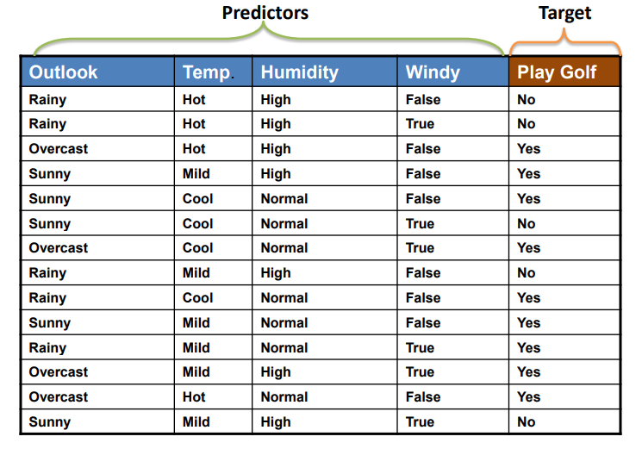
Case Study – Golf Play Dataset

Slide 30
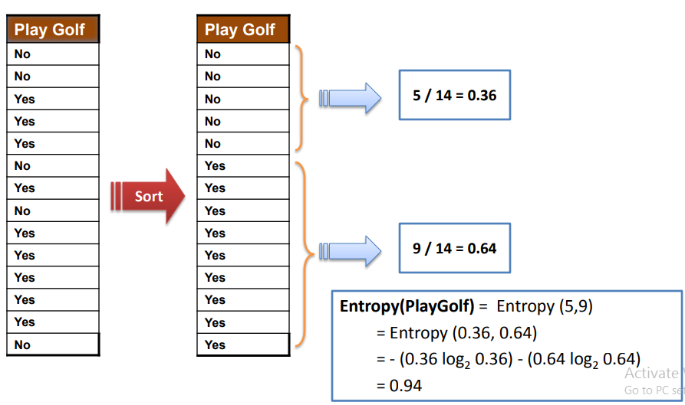
Entropy of Target

Slide 31
Frequency Table

Slide 32
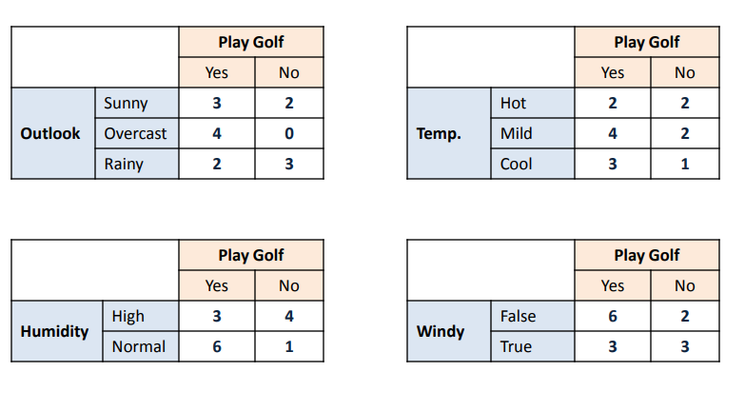
Frequency Table – 4 Attributes

Slide 33
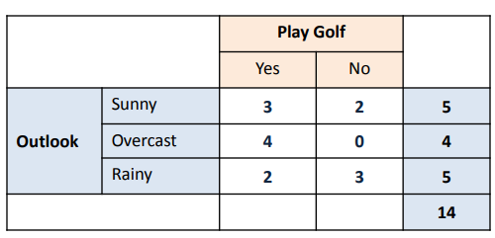
Entropy - Outlook

Slide 34
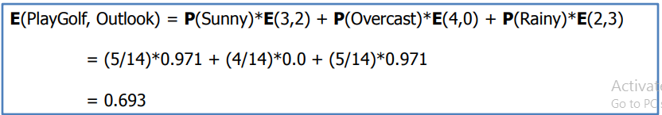
Entropy - Outlook

Slide 35
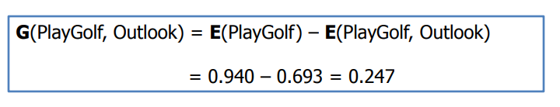
Information Gain - Outlook

Slide 36
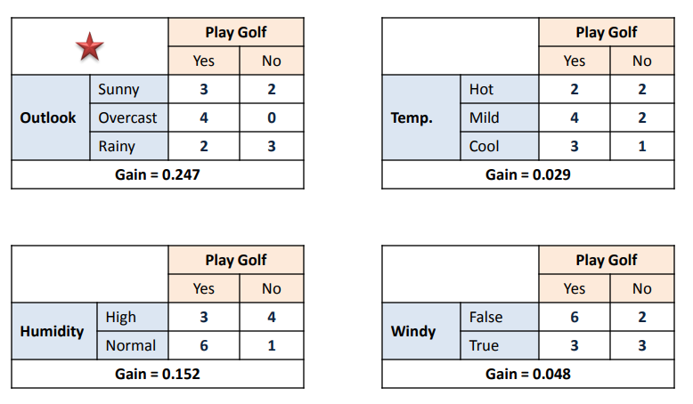
Information Gain - All Attributes

Slide 37
Construction of Tree

Slide 38
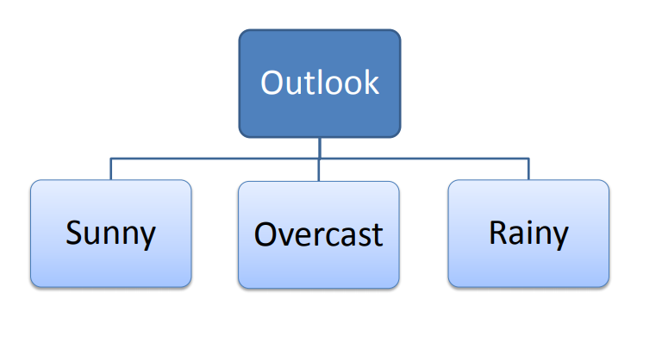
Construction of Tree

Slide 39
Golf Play Dataset

Slide 40
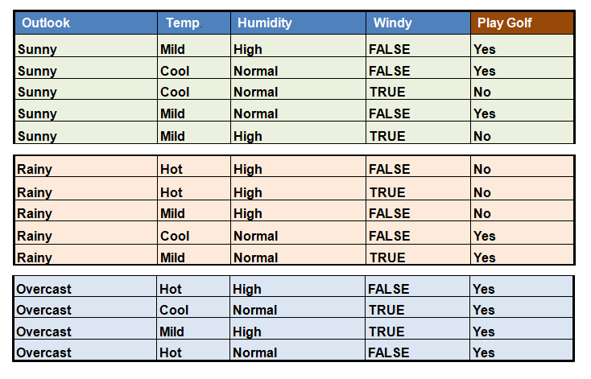
Let’s iterate the process (excluding Outlook)

Slide 41
Next Overcast

Slide 42
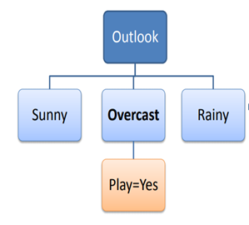
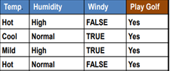
Overcast

Slide 43
Next Sunny

Slide 44
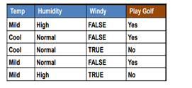
Sunny

Slide 45
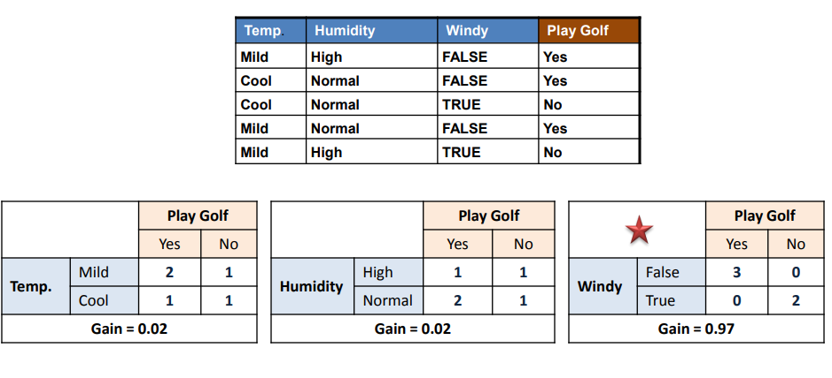
Sunny

Slide 46
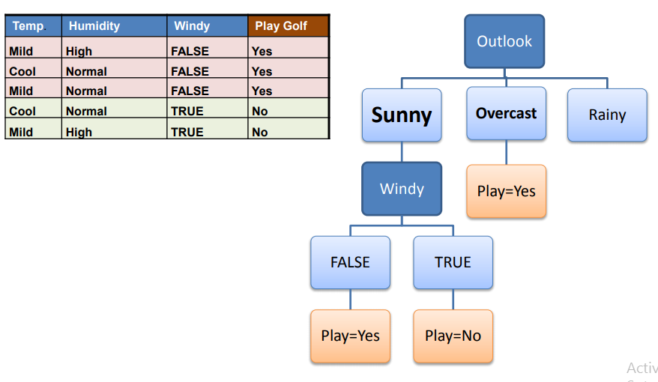
Construction of Tree

Slide 47
Next Rainy

Slide 48
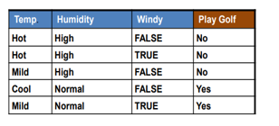
Rainy

Slide 49
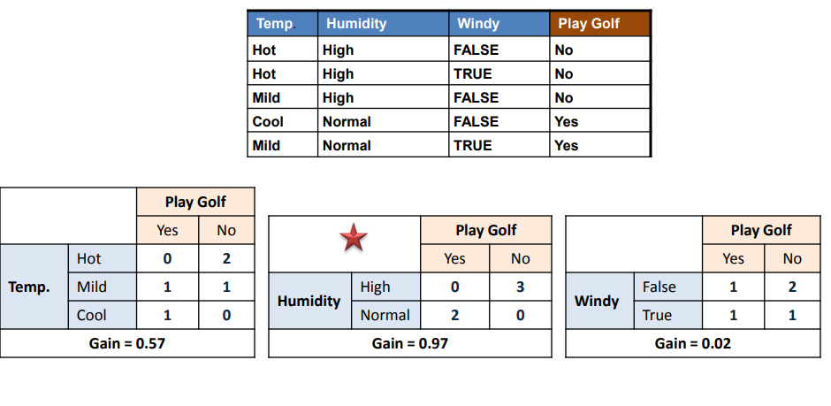
Rainy

Slide 50
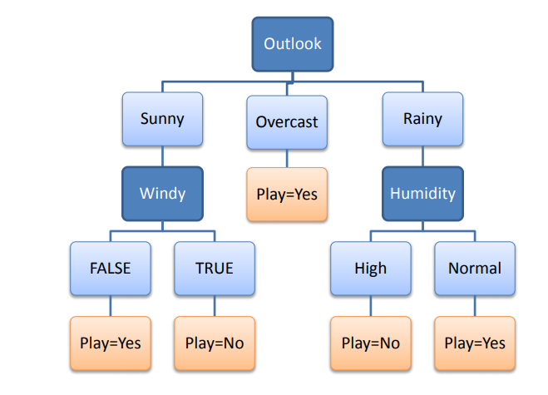
Final Tree Structure

Slide 51
Predict the Play – D15 ?

Slide 52
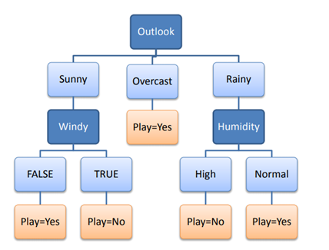
Predict the Play – D15 ?

Slide 53
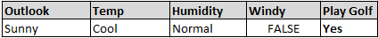
Predict the Play – D15 ?

Slide 54
Decision Rules – Traditional approach

Slide 55
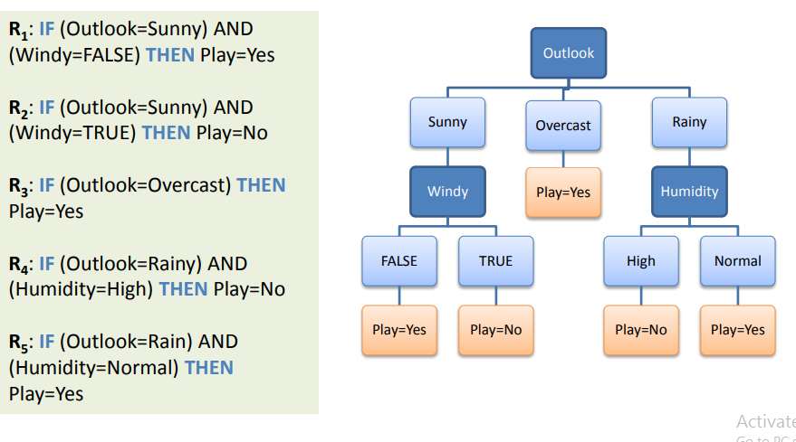
Decision Rules – Traditional approach

Slide 56
Gini Index

Slide 57
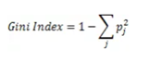
Finding Root using Gini Index
The steps to build the tree using Gini Index approach is same as the Entropy.
Gini Index is the default method of building the Decision Tree

Slide 58
Problem with Trees

Slide 59
Problem with Trees
How will a tree structure look if there are N columns

Slide 60

Problem with Trees
How will a tree structure look if there are N columns

Slide 61
Overfitting
How will a tree structure look if there are 30 columns

Slide 62

When to stop splitting ?

Slide 63
Pruning - To Avoid Overfitting

Slide 64
Pruning
1. Pre-pruning 2. Post-pruning

Slide 65
...

Slide 66
... 2

Slide 67
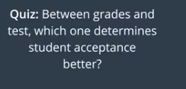
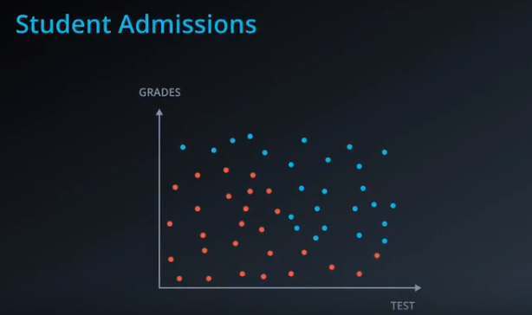
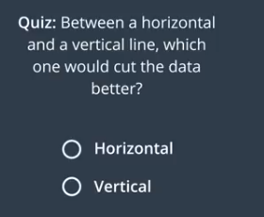
Continuous Data
Or

Slide 68
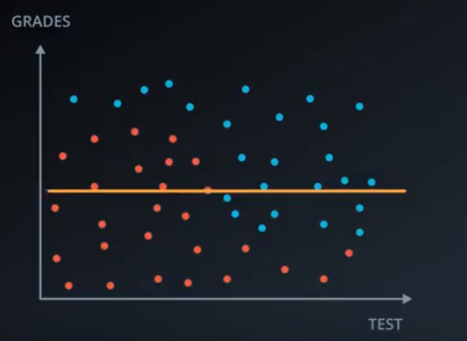
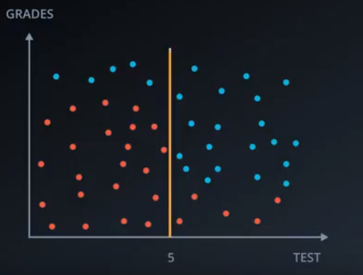
Horizontal vs Vertical

Slide 69
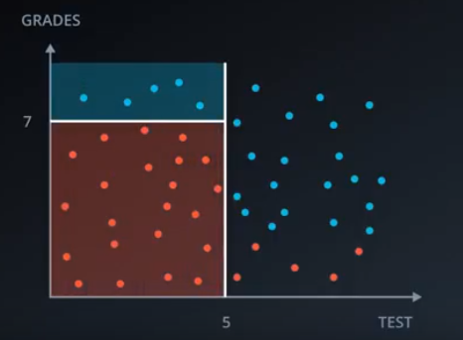
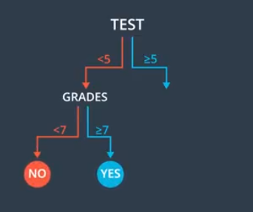
Construction of a Tree

Slide 70
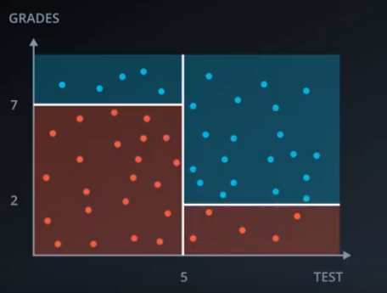
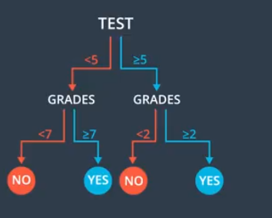
Decision Tree – Manual Structure

Slide 71
Ensemble

Slide 72
Ensemble
Bagging
Boosting

Slide 73


Ensemble
Machine learning paradigm which combine weak learners to become a strong learner

Slide 74
Random Forest (Most used algorithm)

Slide 75
Random Forest (Most used algorithm)
- Bagging Technique (Bootstrap aggregating - Bagging)

Slide 76


Slide 77


Slide 78


HOW THE RANDOM FOREST ALGORITHM WORKS IN MACHINE LEARNING
- Supervised learning algorithm
- Regression and classification problems

Slide 79

Bagging

Slide 80
Random Forest pseudocode
Randomly select “k” features from total “m” features.
Where k << m
For classification a good default is: k = sqrt(m)
For regression a good default is: k = m/3
Among the “k” features, calculate the node “d”.
Split the node into daughter nodes.
Repeat 1 to 3 steps
Build forest by repeating steps 1 to 4 for “n” number times to create “n” number of trees.

Slide 81
Key Points
Majority voting.
Higher the number of trees in the forest = High accuracy.
When we have more trees in the forest, random forest classifier won’t overfit the model.
For each bootstrap sample taken from the training data, there will be samples left behind that were not included. These samples are called Out-Of-Bag samples or OOB.
The performance of each model on its left out samples when averaged can provide an estimated accuracy of the bagged models. This estimated performance is often called the OOB estimate of performance.

Slide 82

Random Forest - Skeleton

Slide 83
Important hyper-parameters for RF tuning:
n_estimators
max_features
max_depth
min_sample_split
min_sample_leaf
n_jobs
oob_score
bootstrap
random_state

Slide 84

Before max_depth tuning:

Slide 85

After max_depth tuning:

Slide 86
Boosting

Slide 87

AdaBoost (Adaptive Boosting)

Slide 88

AdaBoost – Pattern 1

Slide 89

AdaBoost – Pattern 1

Slide 90

AdaBoost – Pattern 2
Apply pattern 2 on the Input Data from pattern 1

Slide 91

AdaBoost – Pattern 2
Input Data

Slide 92

AdaBoost – Pattern 3
Apply pattern 3 on the Input Data from pattern 2

Slide 93

AdaBoost – Pattern 3
Input Data

Slide 94




AdaBoost – Pattern 1 Weights after applying pattern 1

Slide 95




AdaBoost – Pattern 2 Weights after applying pattern 2

Slide 96


AdaBoost – Pattern 3 Weights after applying pattern 3

Slide 97

AdaBoost – 3 Models

Slide 98

Weightage of a Model

Slide 99

Weight of Model 1

Slide 100

Weight of Model 2

Slide 101

Weight of Model 3

Slide 102

Weight of 3 Models

Slide 103

Assinging weights to 2 categories

Slide 104


Slide 105



Slide 106



Slide 107


Slide 108


Slide 109


Slide 110

Final Model

